Slide 1
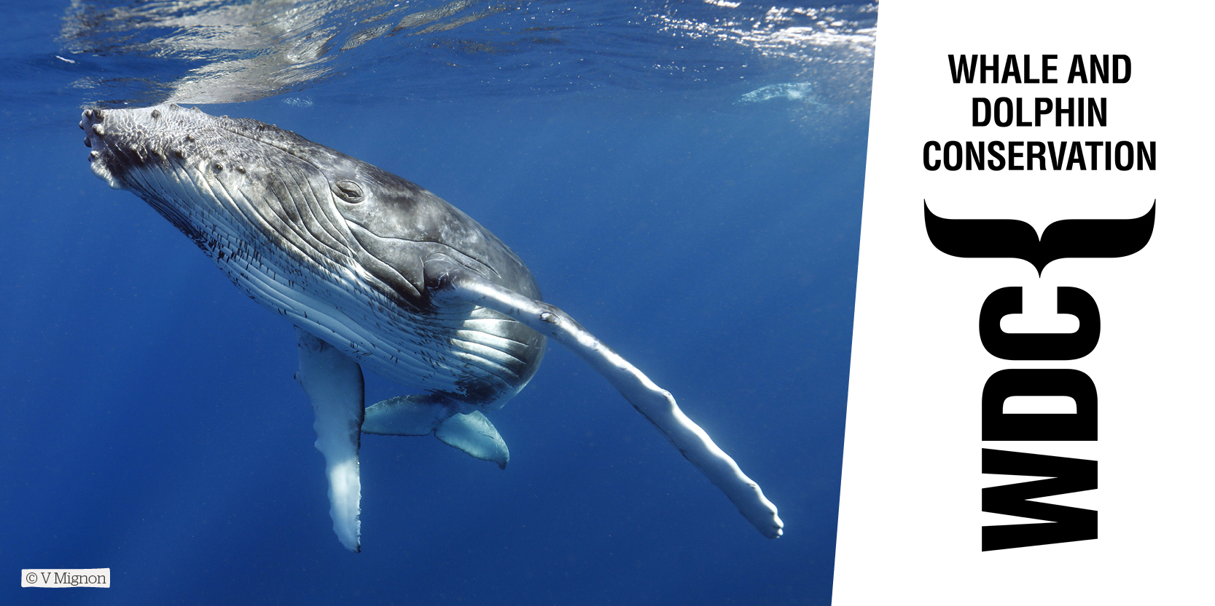
Habitats

Slide 2
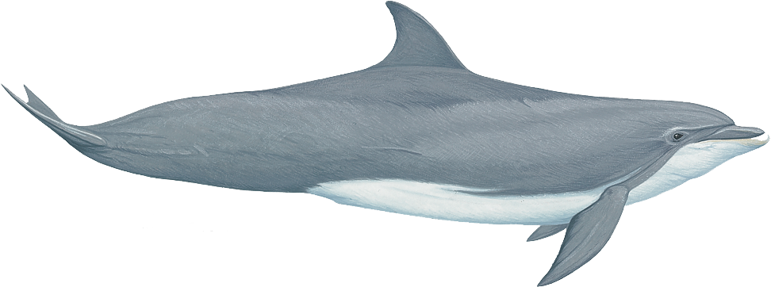
Whales, Dolphins and Porpoises
Diversity of whales video
Notes:
Whales, dolphins and porpoises are collectively called “cetaceans”.

Slide 3
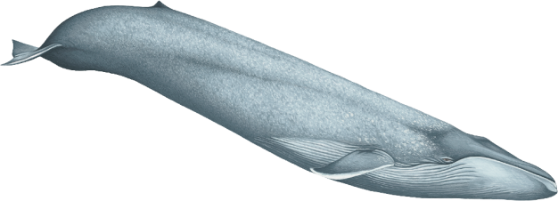
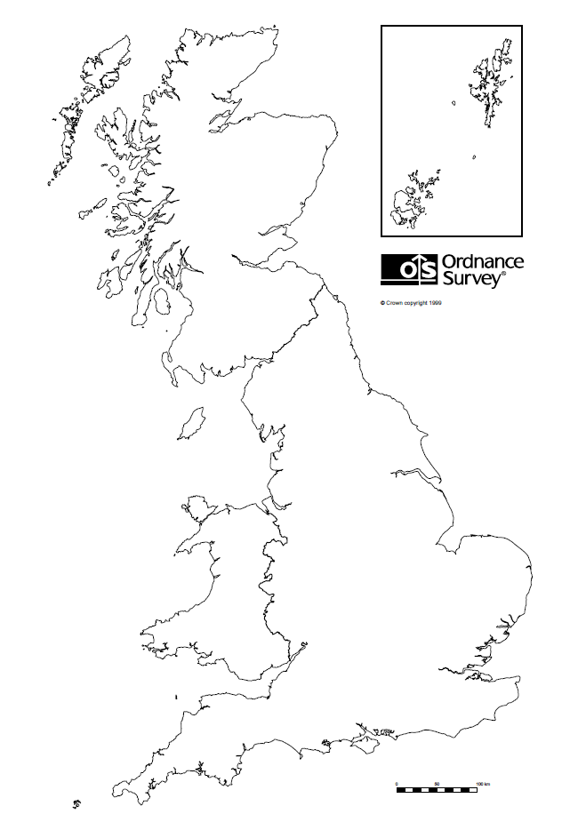
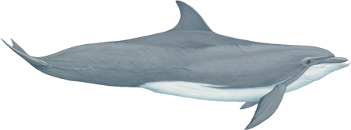
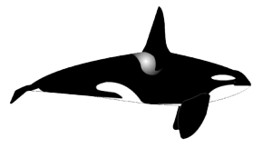
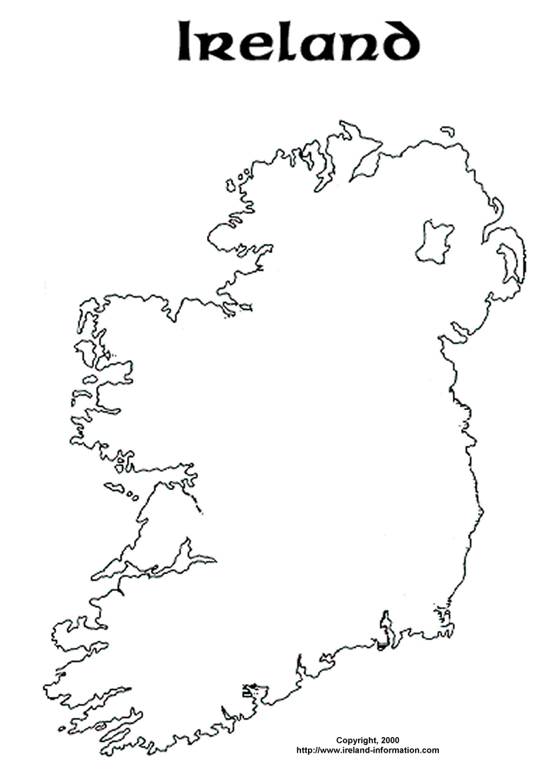
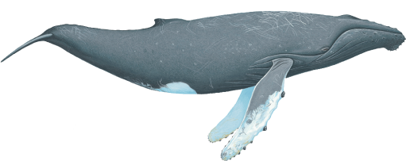
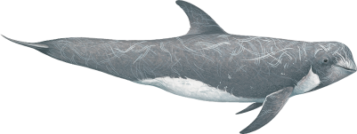
This map shows where some of them are usually seen.
Blue whale
Bottlenose dolphin
Minke whale
Orca
Humpback whale
Risso’s dolphin
Harbour porpoise
Common dolphin
Sperm whale
Notes:
23 different kinds of whales and dolphins have been spotted around the coast of Britain, including the biggest in the world – the blue whale. The most commonly spotted species are the harbour porpoise, which is the smallest British cetacean (about 1.5m long), the bottlenose dolphin, common dolphin and minke whale.

Slide 4
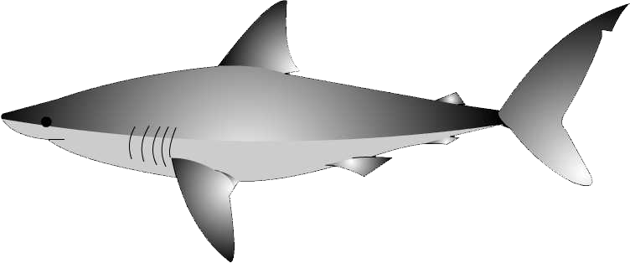
What are the differences between dolphins and fish?
Warm blooded
Cold blooded
Mammals
Fish
Notes:
Whales, dolphins and porpoises are mammals. But, people through history have confused them with fish. Why do you think this is? How do you know they are not fish?
Whales and dolphins are warm-blooded, like us. Fish are cold-blooded, and they feel cold when you touch them. Warm-blooded means they can keep their body temperature constantly warm all the time. Fish can’t do this.

Slide 5
What are the differences between dolphins and fish?
2. Breathe air through lungs
2. Use gills to extract air from water
Mammals
Fish
Notes:
How about breathing?
Whales and dolphins have lungs, like us, and they have to come to the surface to breathe air.
How do fish breathe?
They have gills which extract oxygen straight from the water (the oxygen is dissolved into the water). Whales and dolphins have to come to the surface to breathe, just like we do when we go swimming.

Slide 6
What are the differences between dolphins and fish?
All whales and dolphins give birth to live young
3. Most fish lay eggs
Mammals
Fish
Notes:
Whales and dolphins (and almost all other mammals) give birth to live young – smaller versions of themselves. (Exceptions are the duck-billed platypus and the echidna, which are mammals that lay eggs – but they do feed their young milk, which is true of all mammals, including whales and dolphins).
Most fish lay eggs. The egg case you can see in the picture here is called a mermaid’s purse. Some sharks lay these.

Slide 7
What are the differences between dolphins and fish?
4. Move tails up and down
4. Move tails side to side
Mammals
Fish
Notes:
Another difference between fish and whales and dolphins is the way they swim. Whales and dolphins swim by moving their tail flukes up and down. Fish move their tails from side to side.

Slide 8
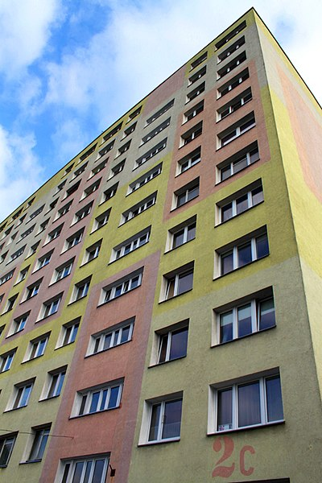
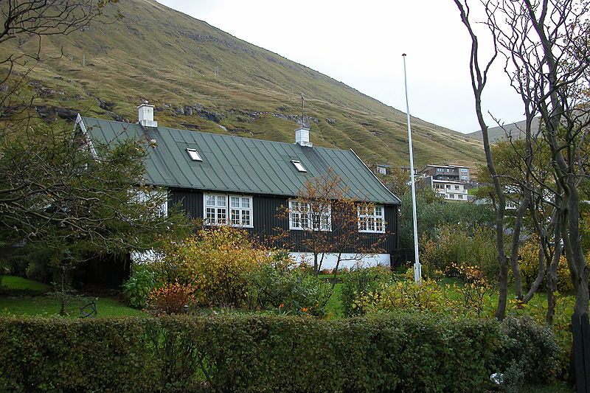
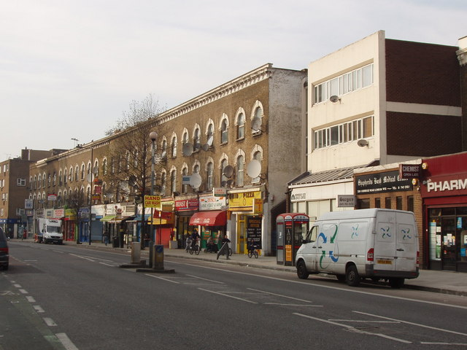
Habitats
What do people need to survive and be happy?
What would be the advantages and disadvantages of living in these different places?
Notes:
Class discussion:
What is a habitat? – The place an animal lives.
Here are some human habitats.
What do people need to survive and be happy?
Examples:
Food and drink
Friends and family
Shelter
Safety
Fun/entertainment/things to do/play
Space/places to go
What would be the advantages and disadvantages of living in these different places?
Example advantages and disadvantages:
Noisy/quiet/too quiet!
Need to go a long way to get food/shops close by
Near to/far away from friends/other people
Lots of space/cramped

Slide 9
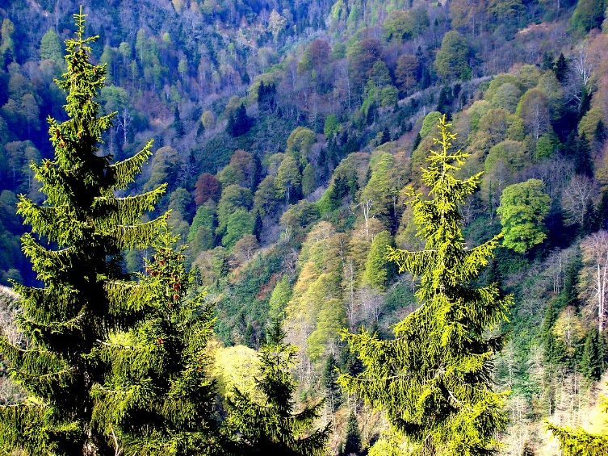
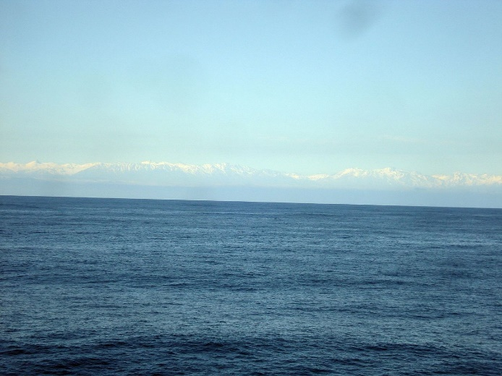
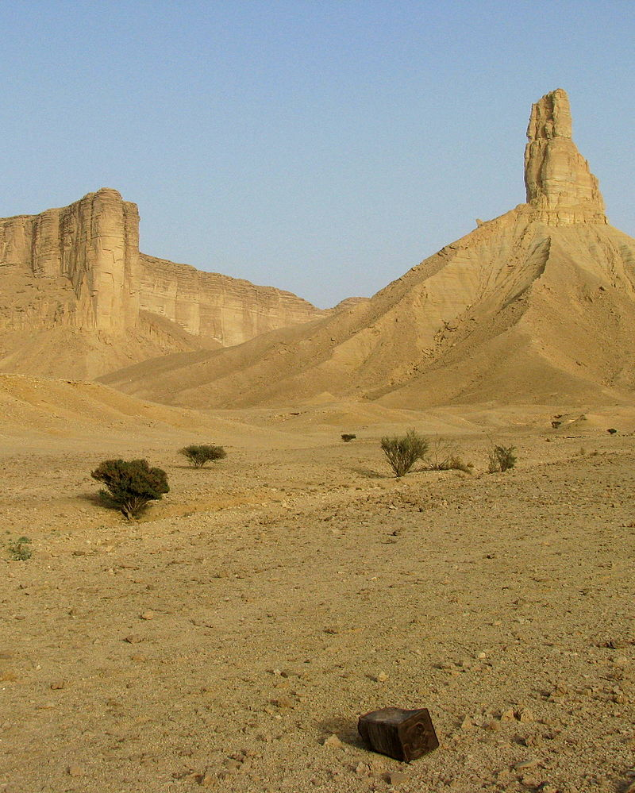
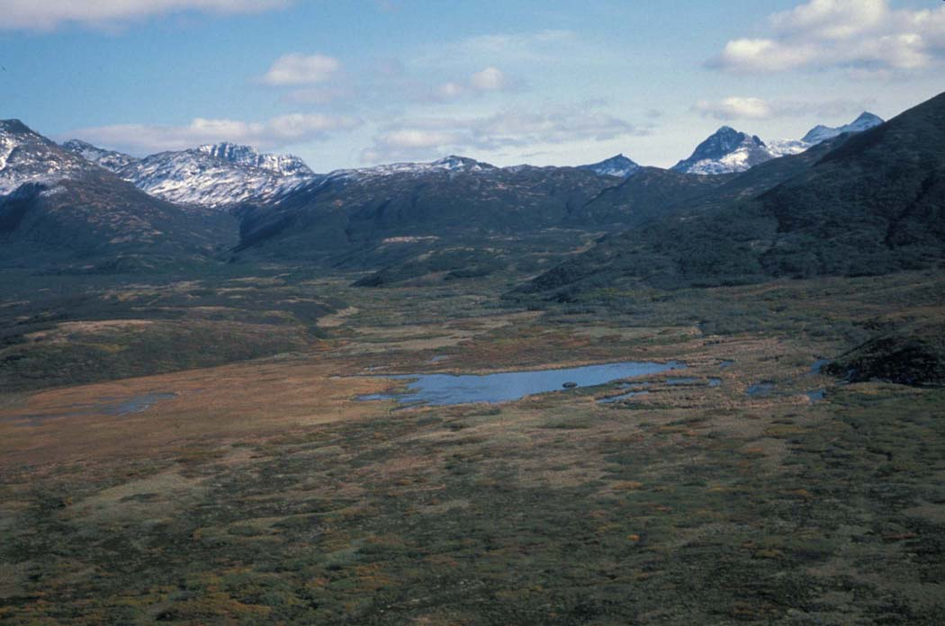
Class activity: What lives in this habitat?
Forest
Ocean
Tundra
Desert
Notes:
In which habitat does each animal live?
What adaptations do the animals have to live in their habitat?
Examples:
Camouflage – e.g. being green in the forest, being white/brown in the tundra, beige in the desert
Adaptations for swimming in the sea – streamlined, flippers
To keep warm in the sea/tundra – blubber, thick fur
Being able to climb or perch in the forest
There is also an online version of this activity for children to complete on iPads/tablet computers: https://docs.google.com/drawings/d/1S6OTf5WP4B0jRAa4frkq3sJ_WYaeazafEmJgTX4Pxys/edit?usp=sharing
Make sure the children create a copy of the file before they begin the activity so they don’t overwrite the master (File → Make a copy).

Slide 10
Whale and dolphin habitats
What do whales and dolphins need to be happy and healthy in their habitat?
Notes:
Ask the children to write on whiteboards as many things as they can think of that whales and dolphins need in their habitats, or do this as an all-class activity.
Examples:
Food (e.g. fish, shrimps)
Clean water
Lots of open space to explore, play, catch food, spend time away from others if they want to, exercise
Other whales/dolphins (friends and family)
Quiet (they find noise stressful, and it makes it hard for them to catch their prey and communicate)
Many of the things whales and dolphins need are the same as people need.

Slide 11
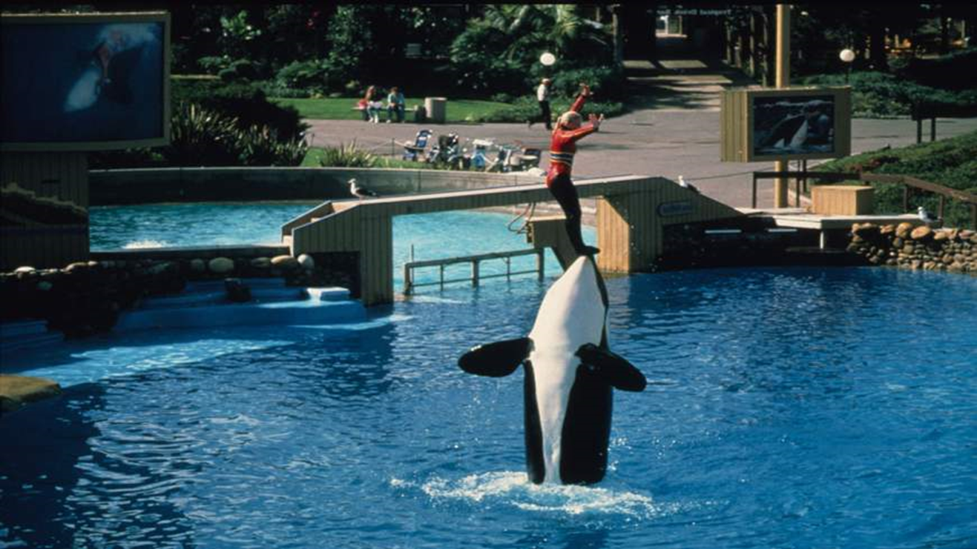
What’s wrong with this?
Notes:
Whales and dolphins suffer in captivity because they don’t have the vital things they need to thrive.
They are separated from their pod (social group of family and friends) and may be kept alone
They don’t have enough space to swim around or to get away from other whales/dolphins they’re kept with if they want to
There is no food to hunt
The water contains chlorine which damages their skin
It’s very noisy and stressful
They don’t have freedom to choose what they want to do
There is nothing to keep them interested so they become frustrated and stressed
They are exposed to diseases
They can’t get proper exercise

Slide 12
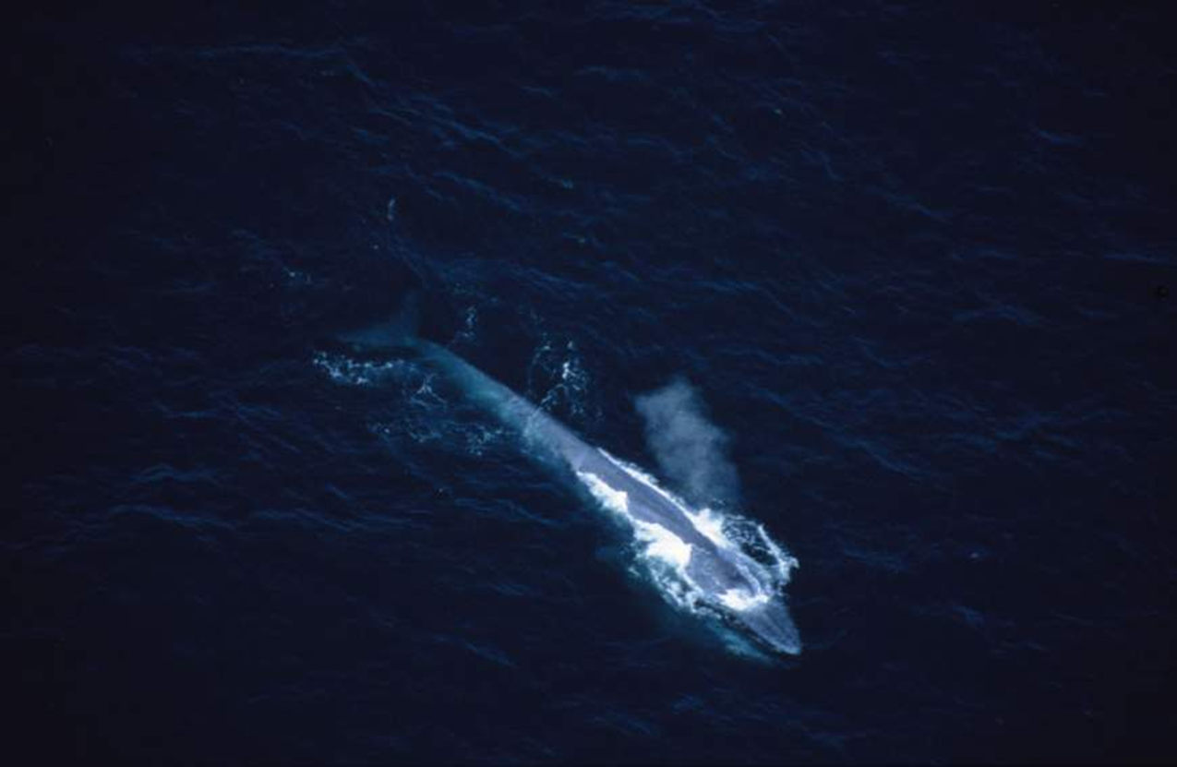
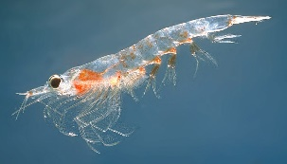
Maximum Weight: 200,000 kg
Maximum Length:
Male: 25-28m
Female: 30m
Calf: 4m
Blue Whale
Diet: Krill (Length = 5cm!)
Eats 40 million every day!
Notes:
The blue whale is the biggest whale – and is the biggest creature that has ever lived on Earth!
So what does a blue whale need in its habitat? – Lots and lots of space, and lots of food!

Slide 13
Class activity: How big is a blue whale?
Notes:
Blue whales can grow over 30 metres (around 100ft) long, which is over twice as long as a t-rex dinosaur – and makes them the largest creature on Earth! A newborn baby blue whale is around 7 metres in length, around the same as an adult African elephant. They eat krill which are 5cm long! Once you have measured out your Blue whale see if your can work out how many 5 cm long krill it would take to fill the whale!

Slide 14
River dolphins
Notes:
Not all whales and dolphins live in the ocean – some dolphins live in freshwater rivers. They have tiny eyes and long snouts. The water they live in is muddy, and so most can’t really see very well, so their eyes have become very small and they rely on their sense of hearing to navigate through echolocation. This is where the dolphin sends out a focused beam of sound, which bounces back off their prey or other objects. They listen for these echoes and use them to navigate.

Slide 15
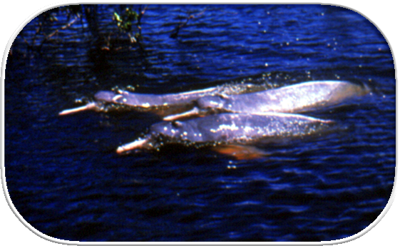
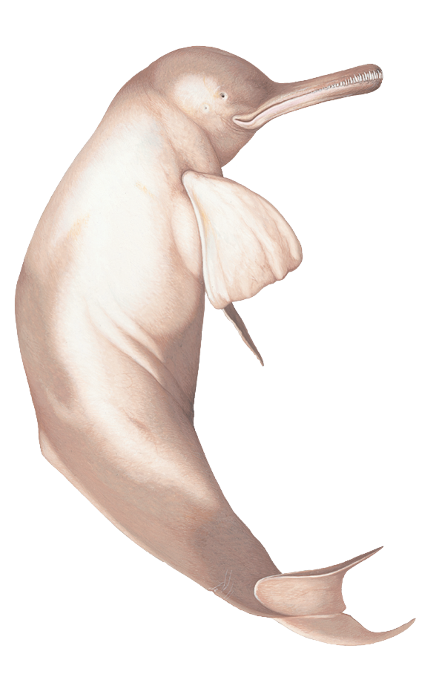
Endangered species
Amazon River dolphins
River dolphins are among the most endangered creatures
in the world
Notes:
Although the vast majority of whales and dolphins are marine – living in seas and oceans - some species of dolphin live in rivers. There are four species of true river dolphins that ONLY live in freshwater. River dolphins are among the most endangered dolphins in the world.
a) This is the Amazon River dolphin, also known as the boto. River dolphins have long beaks and many teeth. Amazon River dolphins eat fish, crabs, shrimps and small turtles. Their rear teeth are modified for crushing (most other dolphins’ teeth are all the same conical shape). This river dolphin has quite good eyesight, but some others such as the Ganges or Indus River dolphins cannot see well – they are not actually blind, but their eyes have no lens, so images are not focused. They all use echolocation to find their way around underwater and for hunting.

Slide 16
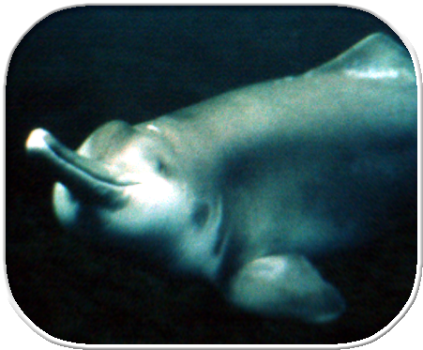
Endangered species
NOW
EXTINCT
Baiji (Yangtze) River dolphin
Amazon River Dolphin
Species of river dolphins are found in South America and Asia.
The Yangtze river dolphin of China is now extinct.
Their eyesight is poor, so they rely on echolocation to find their way around & hunt
Notes:
b) This is the Baiji, or Yangtze River, dolphin. Sadly they became extinct in 2007.
c) Other species, such as the Ganges River dolphin are also in trouble. What word would you use to describe a species whose numbers are very low and declining? (Endangered.)

Slide 17
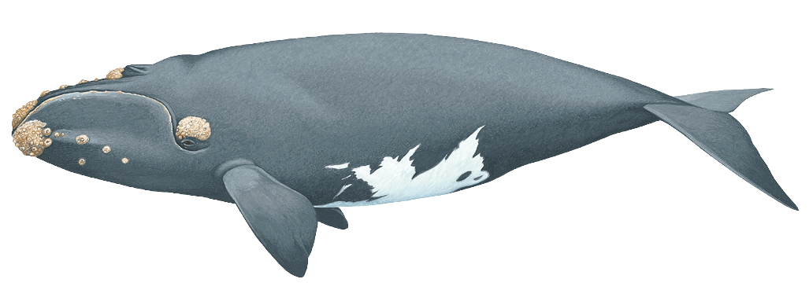
Endangered species
There are
fewer
than 500 North Atlantic right whales left.
Their biggest threat was, and still is, people.
Threats to whales video
Notes:
Many species of whale and dolphin are endangered. That means their numbers are very low – so low that they may become extinct.
Can the children think of any other animals you know of that are endangered? (Tigers, for example).
One species that was almost hunted to extinction is the North Atlantic right whale. Now there are fewer than 500 left in the world. It’s still possible they will become extinct – their main threats being vessel strikes (being hit by moving ships and boats) and entanglement in fishing gear which can cut into them and stop them moving freely.
Right whales are so-called because whalers thought they were they ‘right’ whale to kill as they were easy to catch and yielded lots of oil.
They like coastal waters, where they give birth. Unfortunately these are the waters where most fishing boats and ships are found.

Slide 18
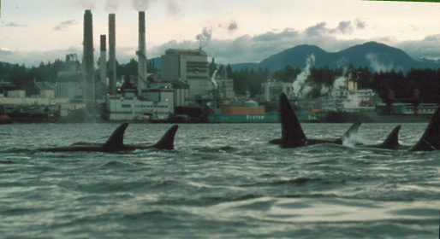
What threats can you see?
Notes:
People are causing lots of damage to the ocean habitat, making it dangerous for whales and dolphins.
What threats to whales and dolphins can you see in these pictures?
1. Pollution – toxic pollution could get into the water, and the emissions will contribute to climate change, which is harming marine animals like whales and dolphins, for example by making the ocean more acidic.

Slide 19
What threats can you see?
Notes:
2. Ships – many whales and dolphins die when they are hit by boats and ships.

Slide 20
What threats can you see?
Notes:
3. Large fishing net – the biggest killer of whales and dolphins is “bycatch”. They become entangled in fishing nets and can’t get to the surface to breathe, so they drown.

Slide 21
What threats can you see?
Notes:
4. Noise - whales and dolphins can get hit by boats, which injure or kill them, but they also find it difficult to use echolocation to find their food, and to communicate with each other, because of the loud noise created by the boats.
In the ocean, sound travels much further than it does on land, so these boats could be harming whales and dolphins many miles away.

Slide 22
What threats can you see?
Notes:
5. Climate change - This shows the melting ice caps, an indicator of climate change causing increases in water temperatures.

Slide 23
What threats can you see?
Notes:
6. Balloons – when you let go of balloons they often end up in the sea, as over two thirds of the Earth’s surface is ocean. Whales and dolphins can mistake them for food and eat them. The balloons can get stuck inside a whale’s stomach and cause it to die.

Slide 24
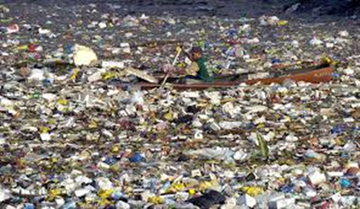
What threats can you see?
Notes:
7. Ocean litter and plastic pollution – more than half of whale and dolphin species have been recorded eating plastic litter, mistaking it for food. For example, plastic bags look a lot like jellyfish to dolphins, so they accidentally eat them. In 2017, a dead Cuvier’s beaked whale washed up on a beach in Norway. It had died as its stomach had become obstructed with plastic waste, including 30 plastic bags, some of which were British.

Slide 25
Class activity: Ocean “musical chairs”
Notes:
Play the game to see the impact of humans on whale and dolphin habitats and numbers.

Slide 26
Notes:
Where do whales live? Whales live in every ocean on the planet. They can be found in temperate oceans and tropical waters around the equator, as well as in the freezing Arctic and Antarctic waters. Some whale species can be found in seas, including the North Sea and the Mediterranean. Whale migrations between breeding and feeding grounds can often take them through high boat traffic areas.

Slide 27
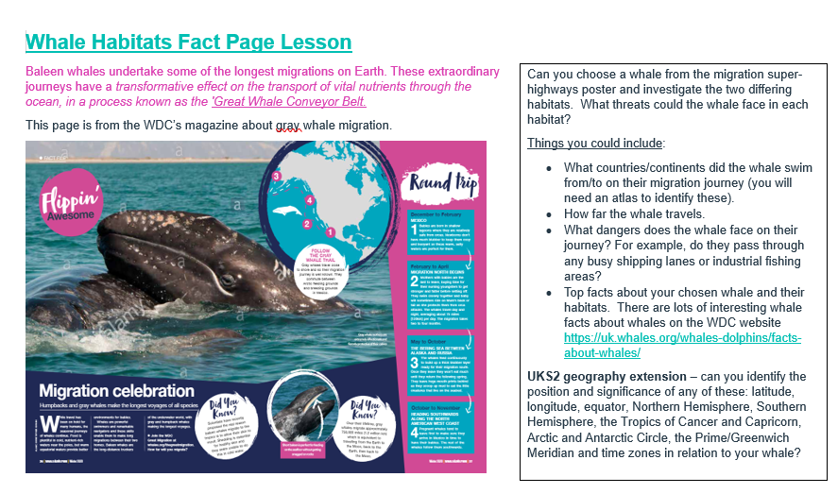
Class activity: Whale habitat facts
Notes:
Based on what they’ve learnt about what whales and dolphins need to be safe, happy and healthy, can they design a poster to show both a good and a bad whale and dolphin habitat?

Slide 28
Class activity: Good and bad habitat posters
Notes:
Based on what they’ve learnt about what whales and dolphins need to be safe, happy and healthy, can they design a poster to show both a good and a bad whale and dolphin habitat?

Slide 29
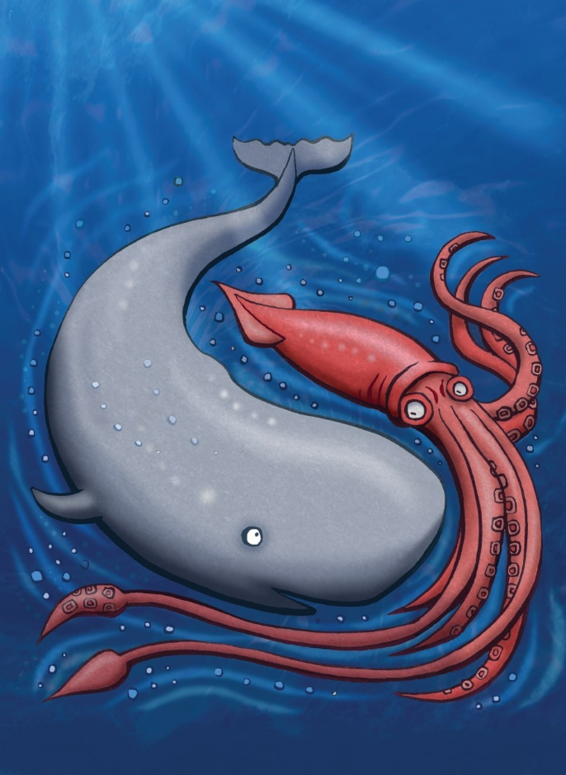
Class activity: Habitats quiz
Notes:
https://play.kahoot.it/#/k/5a1bd615-3418-45bc-b2a6-1f1c8c50fc80
To join in, the children will need to use iPads/tablet computers connected to the internet.

